Slide 1
FMC Tower
at Cira Center South
By: Mick Giraso
Jonathan Swartz
Haoying Ye

Slide 2
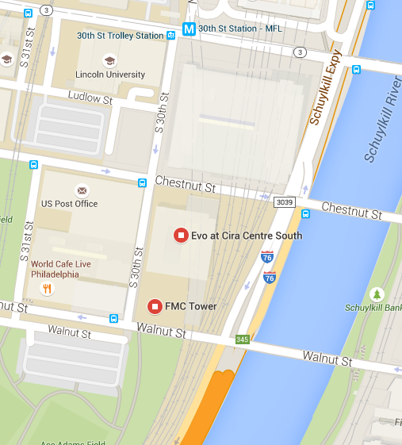
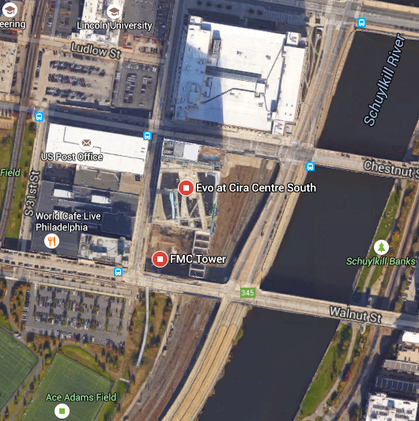
Site Location
Corner of 30th Street & Walnut Street
Southernmost building in Cira Center South

Slide 3
Description
Third and last addition to the Cira Center Development
Tallest building in the development with 50 stories
730 ft tall
6th tallest in Philadelphia
Lawn area on top of parking garage
Entire site and building is “Vertical Neighborhood”

Slide 4
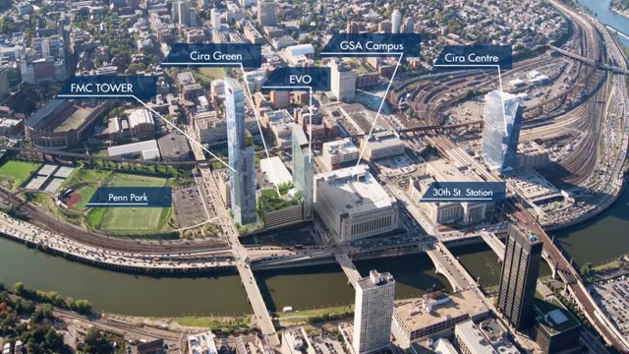
Location
Downtown University City
Neighboring properties:
Penn Park
EVO and Cira Center
30th Street Station
Schuylkill River
Ideal location for both offices and residential
Close to i76

Slide 5
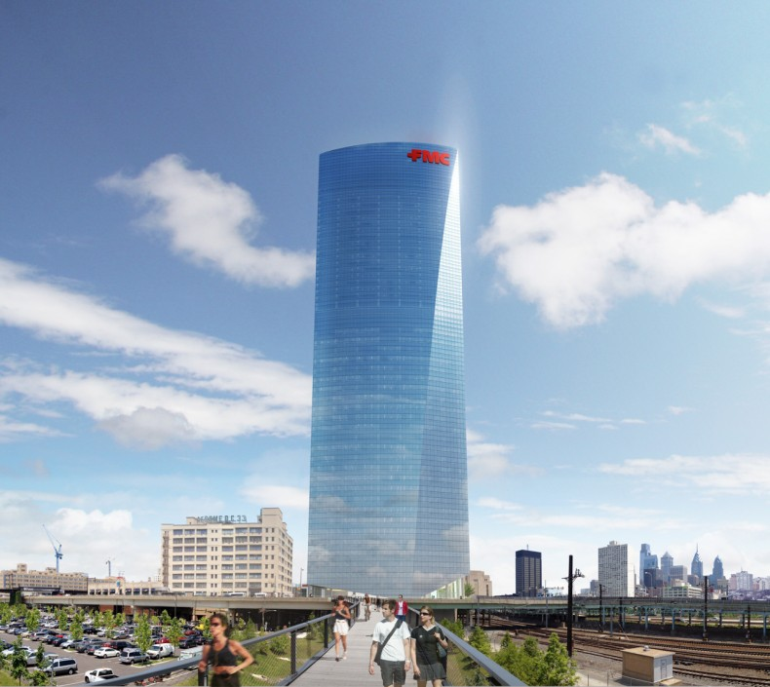
Location
Portions of the site were built over top of Amtrak train rails
Amtrak owns ground area, Penn owns airspace above
Orientation of building intentional
Meant to have “staggering” view over the Schuylkill

Slide 6
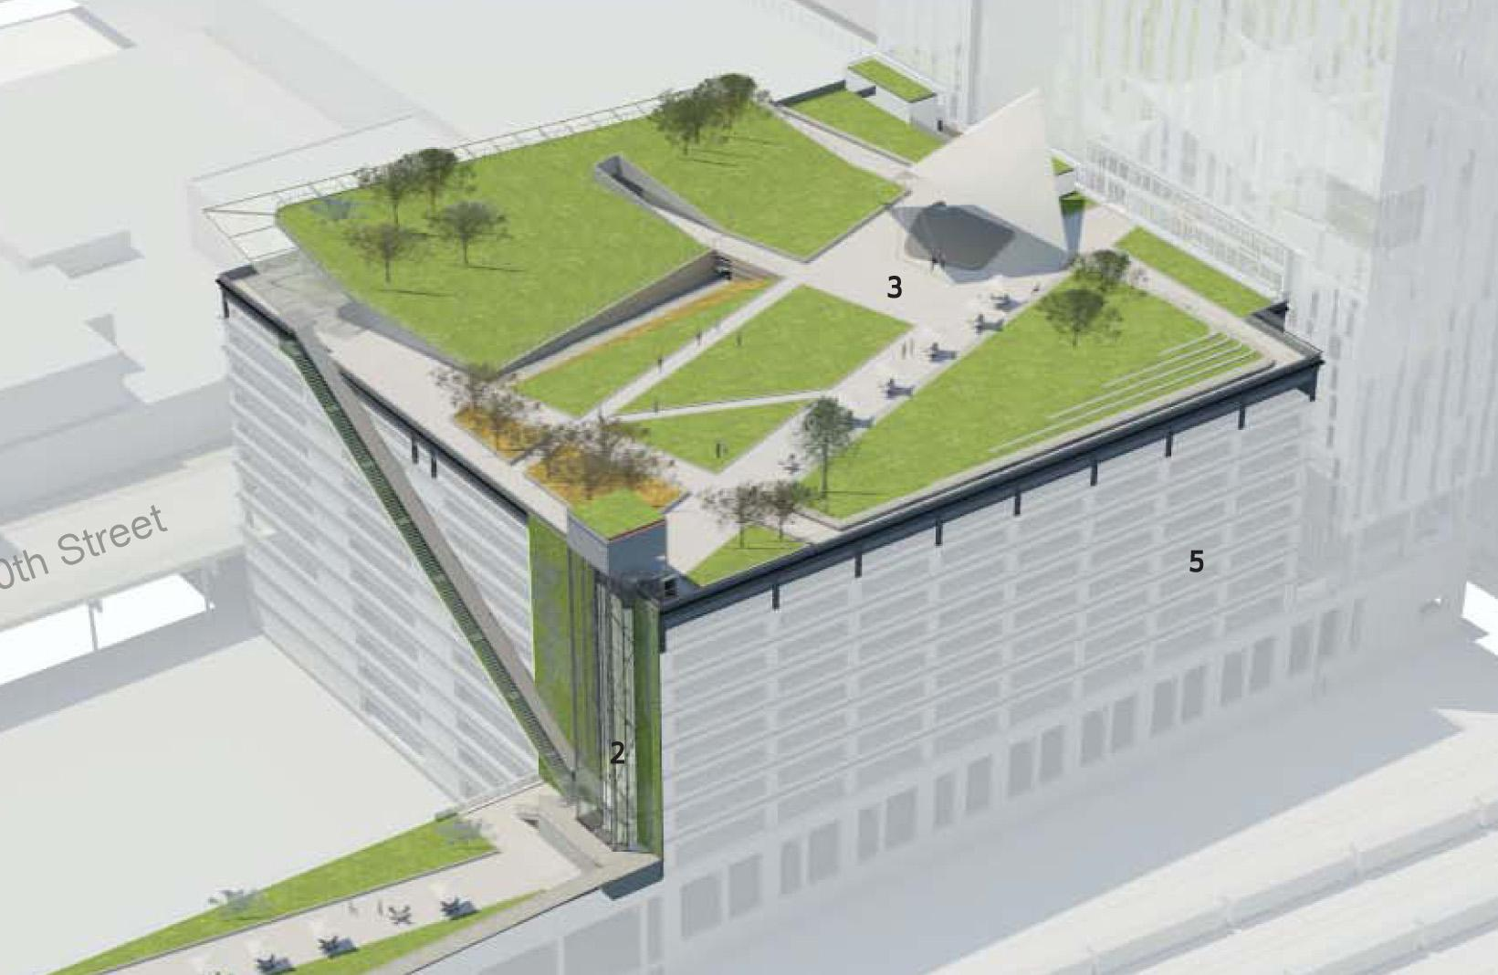
Parking Garage - Cira Green
Green area on top of parking garage
Shared by FMC Tower and EVO
Provides parking, outdoor courtyard area and access to building for residences

Slide 7
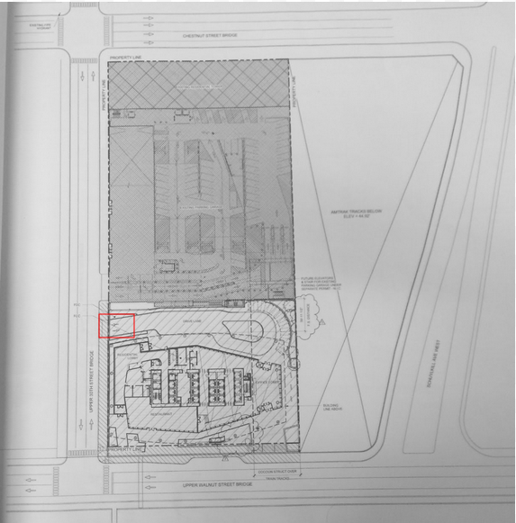
Access to Site
Full movement driveway on 30th Street
Garage is the only car access
Main Entrance on Walnut Street
Pedestrian access on Walnut Street and 30th Street

Slide 8
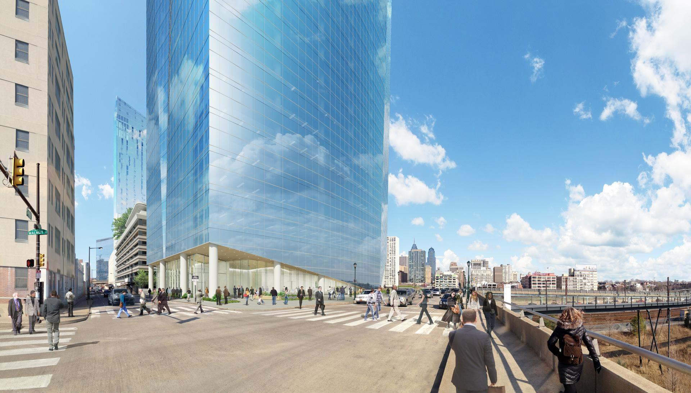
Access Options
The building is meant to be accessed by pedestrians
City location limits the other options
Access is also limited by the size of the site

Slide 9
Access Options
Access on 30th street facilitates access to the existing parking garage
30th street is a 2-way street, allowing the full movement of the driveway
Walnut Street: one- way
Access on Walnut Street would be right ingress/egress

Slide 10
Questions?

